Slide 1
J.B. Hunt
Carrier Payment Procedures
June 2016

Slide 2
Required Documents
Carrier Company Invoice
Bill of Lading (BOL) signed by Customer
All Other Load-Specific Documents, if applicable

Slide 3
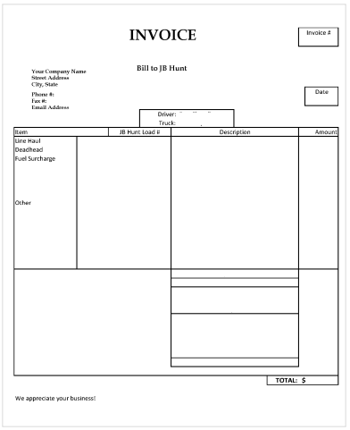
Required Information: Invoice
Company Name
Company Address
Company Contact Information
Rate on Confirmation Sheet
DO NOT:
Use BOL as an invoice
Write dollar amount on BOL
Include lumper service payments on your invoice. See directions at the end of this document for lumper service payment procedures.

Slide 4
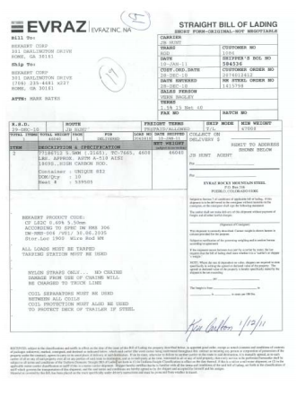
Required Information: Bill of Lading
Once load is delivered:
Obtain BOL from customer
Request customer signature on BOL if not provided
Write J.B. Hunt load confirmation number on BOL
Record arrival and departure times for detention payment, if applicable

Slide 5
Detention Payments
If a driver is detained at a shipper or receiver facility, use the following procedures for detention:
Notify J.B. Hunt within TWO (2) hours of the scheduled pickup/delivery appointment to report the delay
When the delay ends, call or email with the departure time
Record arrival and departure times on Bill of Lading (BOL)
NOTE: Read your entire Carrier Load Confirmation for every load. If there are detention requirements listed in the COMMENTS section of the Load Confirmation, they supersede the procedures listed here

Slide 6
Submitting Documents for Payment
Five Ways to Submit Documents:
Direct Scanning with Transflo Velocity
Mobile Scanning with Transflo Mobile
Remote Scanning with Transflo Express
Email PDF files to qpdocs@jbhunt.com
Fax to 479-820-2718 (NOT recommended)
50%

Slide 7
Submitting Documents for Payment
Transflo Velocity (Recommended)
Use any desktop scanner to send load documents directly to J.B. Hunt
Download for FREE
Use Broker Code JBHV
Fastest processing method
50%

Slide 8
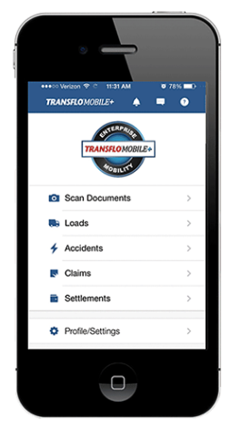
Submitting Documents for Payment
Transflo Mobile (Recommended)
Use your iPhone or Android smartphone to send load documents directly to J.B. Hunt
Download for FREE
Use Broker Code JBHV
Paperless submittal process
50%

Slide 9
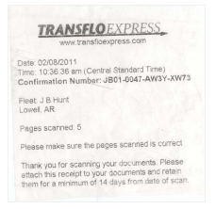
Submitting Documents for Payment
Transflo Express (Recommended)
Document scanning from fuel desks at participating truck stops
Flying J
Loves
Petro
Pilot
TA
Use Broker Code JBHA
Driver receives confirmation receipt from fuel desk
Paperwork MUST be kept for 14 days to ensure proper routing

Slide 10
Submitting Documents for Payment
Email Submissions
Completed paperwork must be submitted as PDF files
Email to: qpdocs@jbhunt.com
Emails received are date/time stamped for tracking purposes

Slide 11
Submitting Documents for Payment
FAX Submissions (NOT recommended)
FAX completed documents to: 479-820-2718
Email to: qpdocs@jbhunt.com
Image quality can be poor
Cannot be tracked

Slide 12
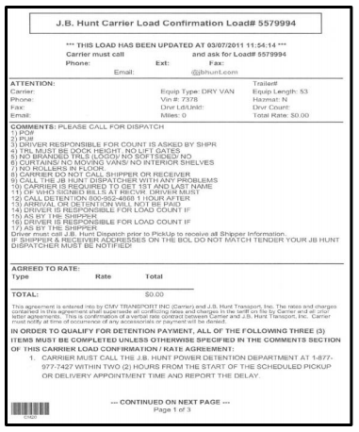
Load Confirmation
Load Confirmation Should Include:
Your rate
7-digit J.B. Hunt load number
Paperwork submission details
Information/instructions on accessorials
Additional carrier information

Slide 13
Lumper Service Payments
DO NOT pay for lumper service from a cash advance or out of pocket – you WILL NOT receive reimbursement
For loads requiring lumper service, do the following:
Call 1-800-UNLOAD1 (1-800-865-6231)
Give the freight specialist your J.B. Hunt load number
The freight specialist will pay the lumper directly

